Slide 1
Introducing Entity Object
(Section 3)

Slide 2
Introduction
The ADF entity object hides the physical database objects from the developers, and enables them to work with data in the form of Java objects and properties, an entity object represents data source definition and an entity instance represents a row in the datasource.
ADF application could be traditional relational database management systems, such as Oracle, MySQL, MS SQL Server, and DB2, or web services, or even third-party services.

Slide 3
Ingredients of an entity object
Entity Definition
Entity Collection(Entity Cache)
Entity Object
Association
Entity Object

Slide 4
Ingredients of an entity object
An entity object is composed of the following components:
Entity object definition XML metadata file: This file is an entity descriptor, which holds metadata definition for the entity. This file stores the following configurations for an entity object
database object on which the entity is built upon. can be built from a database table, view, synonyms, or materialized view.
the attribute definition for each column present in the entity object. This includes the datatype, length, precision, validation rules , UI hints , and updatability of the attribute
View accessors and entity accessor attributes'.
Business event definitions that are used for launching business processes in a service oriented environment.

Slide 5
Ingredients of an entity object
An entity object is composed of the following components:
Entity definition: This class acts as a runtime Java class representation for the entity object definition XML metadata file extended from oracle.jbo. server.EntityDefImpl.
Entity object: This class represents individual entity instance created from the entity definition at runtime extended from oracle.jbo.server.EntityImpl. In simple words, an entity object instance represents a row in the datasource.
Entity collection: This class represents the cache of the entity object class held in memory for a transaction .general class is oracle.jbo.server. EntityCache.

Slide 6
Core features of ADF entity objects
Oracle ADF entity objects are an end-to-end ORM tool with many out-of-the-box features:
Visual and declarative development
Associations
Declarative validation
Entity inheritance
Entity caching
Built-in CRUD operations
Concurrency handling
Customizable framework components
Domain-driven development
Security-enabled business components

Slide 7

Developing entity objects
Creating a database connection
Initializing the ADF model project
Creating entity objects
Using Create Business Components from the Tables option
Using the Create Entity Object wizard

Slide 8
Choosing the database object type
Build entity objects from the following database object types:
Tables
Views : If you want to build entity objects by using the database view to insert, update, or delete table rows, the view should be updatable.
Synonyms: A synonym is an alias for any table, view, or materialized view.
Materialized view: A materialized view is a database object that contains the results of a query.

Slide 9
Generating Java classes for entity components
Entity object class: This class is the more frequently sub-classed class and is used for customizing business logic or runtime behavior for an entity instance
Entity collection class: This class is for customizing the default entity caching implementation.
Entity definition class: For example, if you want to modify the properties of an entity object or attributes of an entity object at runtime, you can override the resolveDefObject() method.

Slide 10
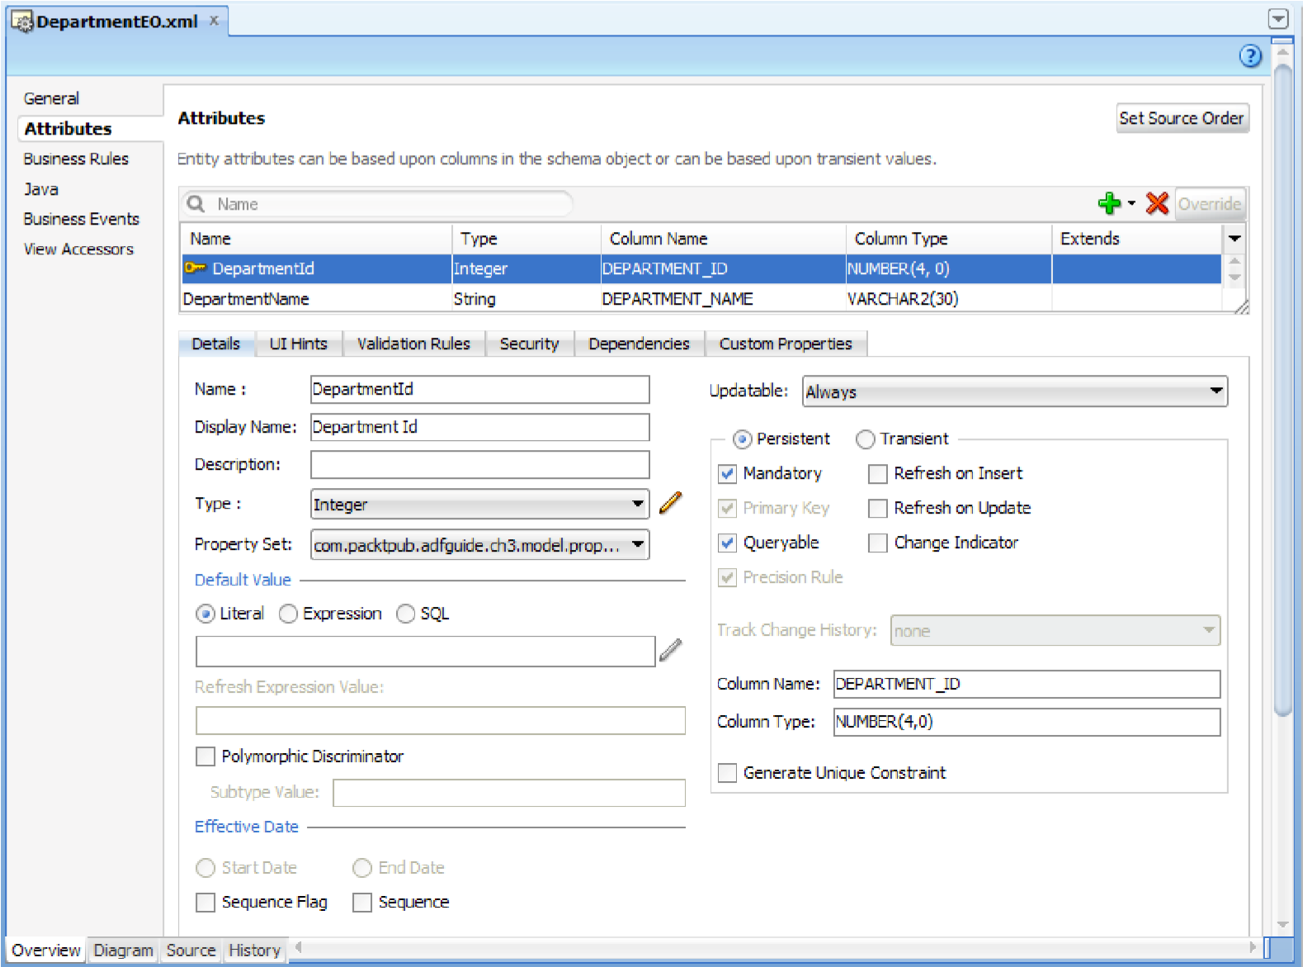
Commonly used properties of an entity attribute

Slide 11
Attribute names in an entity object
When you generate entities, JDeveloper will use the camel-capped attribute naming convention by default. (DEPARTMENT_NAME -> DepartmentName). If you opt to generate an entity object class with accessors (getter methods for attributes) for your entity object.

Slide 12
Attribute types in an entity object
Database column type | Business components attribute type | Description
VARCHAR2 | java.lang.String | VARCHAR2 is mapped to java.lang.String
NUMBER | java.math.BigDecimal | NUMBER type is mapped to java.math. BigDecimal if the scale is not zero or precision is greater than 18
NUMBER | java.lang.Integer | NUMBER type is mapped to java.math. BigDecimal if the scale is zero and precision is between 1 to 9
NUMBER | java.lang.Long | NUMBER type is mapped to java.lang.Long if the scale is zero and precision is between 10 to 18

Slide 13
Attribute types in an entity object
Database column type | Business components attribute type | Description
DATE | java.sql.Date | DATE type is mapped to java.sql.Date if the table column has no time component and client does not need time zone information
DATE | java.sql.Timestamp | DATE type is mapped to java.sql.Timestamp if the table column has time component and client needs time zone information
TIMESTAMP | java.sql.Timestamp | TIMESTAMP type in database is having nanosecond precision
BLOB(Binary Large Object) | oracle.jbo.domain.BlobDomain | BlobDomain supports streaming and lazy data loading
CLOB(Character Large Object) | oracle.jbo.domain.ClobDomain | ClobDomain supports streaming and lazy data loading

Slide 14
Persistent and transient attributes
Attributes that are not persisted in the underlying database source, such as the database table, are transient. A transient attribute's display values are derived from other attributes either by using Groovy expression or through Java code.

Slide 15
Specifying a default value for an entity attribute
A default value is set to the attribute values:
The default value defaults the persistent attribute values when you create a new entity instance
For transient attributes the default value is used when client accesses the attribute as well as during entity instance creation
There are three ways to specify default values for an attribute:
Literal: It is set to default static value.
Expression: It is set to default values by using the Groovy expression.
SQL: The default value is set by using SQL derived expression.

Slide 16
Defining the primary key
The primary key uniquely identifies an entity instance in the collection. If there is no primary key found for the database objects and the underlying database is Oracle, the wizard will pick up the RowID pseudo column, which uniquely identifies a row within a table and marks it as the primary key.
Best practices when defining the primary key:
Do not use the default pseudo column RowId as the primary key to deal with transaction sensitive business data
Prefer surrogate keys over a composite primary key.
Do not allow the user to modify primary key fields from UI.

Slide 17
Defining the primary key
To programmatically find the entity object by using the primary key, you can call findByPrimaryKey() on the corresponding EntityDefImpl .
EntityDefImpl orderDef = EmployeeEOImpl.getDefinitionObject();
objectKey orderKey = EmployeeEOImpl.createPrimaryKey(new Integer(empId)
(EmployeeEOImpl)orderDef.findByPrimaryKey(getDBTransaction(), orderKey);

Slide 18
Updatability of entity attributes
If you do not want an attribute to always be updatable, you can use the Updatable property to control when the value of a given attribute can be updated
Never
While New: An attribute is updatable, if the entity object is newly created
Always: This is the default setting for an attribute.

Slide 19
Refreshing attributes on posting changes to the database
If certain columns in your table are populated through database trigger or stored procedure when the data is posted to the database, it is necessary to refresh the corresponding entity object attributes with values from the database after posting data to the database. You can turn on Refresh on Insert or Refresh on Update for such attributes and the rest will be taken care of by the framework.
BEGIN UPDATE DEPARTMENTS Departments SET DEPARTMENT_NAME=:1 WHERE
DEPARTMENT_ID=:2 RETURNING DEPARTMENT_ID INTO :3; END;

Slide 20
Commonly used properties of an entity attribute
Marking an attribute as mandatory
Checking data inconsistency by using the Change Indicator attribute
Queriable attributes
Tracking change history
Created On
Created By
Modified On
Modified By
Version Id
Configuring UI hints for an attribute
Specifying dependency attributes

Slide 21
Handling Oracle Sequences
There are two ways to getting next value of a Oracle Sequence for a primary key:
Using DBSequenceImple Class
Using Groovy expressions
(new oracle.jbo.server.SequenceImple("SUPPLIER_SEQ" ,adf.object.getDBTransaction())).getSequenceNumber()
Overriding EntityImple create() method
<note> : this way can be used in View Objects too.
Using Trigger
DBSequence

Slide 22
Setting an alternate key for an entity object
An entity may have attributes, which uniquely identify an instance in the collection apart from its primary keys.
The advantages of defining alternate keys are as follows:
Alternate keys are indexed and are useful for finding the entity instance in the cache by executing findByAltKey() on the EntityDefImpl class.
EntityDefImpl empEODef = EmployeeEOImpl.getDefinitionObject();
String email= "jobinesh@xyz.zom";
Key emailAltKey = new Key(new Object[] { email });
EntityImpl employeeEO = empEODef.findByAltKey(getDBTransaction(),
"EmailAltKey", emailAltKey, false, true);
Alternate key attributes can be used to define the Unique Key Validator for an entity.

Slide 23
Defining entity association
The association describes the relationship in the entity data model. When you define an association, the wizard generates an accessor, which can be used for accessing entities participating in the other side of association.
One to One
One to Many
Many to One
Many to Many
Association types | Cardinality in association
One to Many | 0 …1 to * 1 to *
One to One | 0 …1 to 0… 1 0 …1 to 1 1 to 0… 1
Many to One | * to 1 * to 0…1
Many to Many | * to *

Slide 24
Defining entity association
To programmatically access the destination entities, you can use the association accessor generated on entity implementation class, as shown in the following code snippet:
EntityDefImpl deptEODef = DeptEOImpl.getDefinitionObject();
Key deptIdKey = DeptEOImpl.createPrimaryKey(new Integer(deptId));
DeptEOImpl deptEOImpl = (DeptEOImpl)departmentEODef.findByPrimaryKey(g etDBTransaction(), deptIdKey);
RowIterator rowIter= DeptEOImpl.getEmpEO(); while(rowIter.hasNext()){ Row row=rowIter.next();}

Slide 25
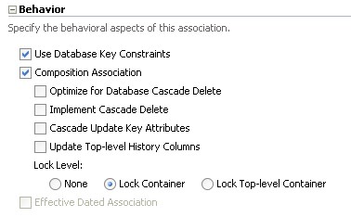
Composition association
Association type, which we discussed in the previous section, relates source with destination entities where both parties can exist independent of each other. However, this may not be true for all relations. For example, consider the relation between car and engine, where the engine cannot exist without the car.

Slide 26
Retaining the association accessor row set
If your code makes multiple calls to the same association accessor attribute while serving a request, you can try fine-tuning the execution by opting for retaining the association accessor row set.
RowIterator rowIter= DeptEOImpl.getEmpEO();
rowIter.reset();

Slide 27
Creating new Entity
String amDef = "model.AppModule";
String config = "AppModuleLocal";
ApplicationModule am = Configuration.createRootApplicationModule(amDef, config);
PersonsImpl newPerson =
(PersonsImpl)PersonsImpl.getDefinitionObject().createInstance2((DBTransaction)am.getTransaction(), null);
newPerson.set… ;
am.getTransaction().commit();
Configuration.releaseRootApplicationModule(am, false);

